Slide 1
team APACHE: Predicting the next big coin in cryptocurrency market
Group Members:
ORINA TOLULOPE O.
ABIOLA LAWANI
YAHYA MARYAM ADEOLA
AKINBO GBEKELEOLUWA
SINJINI
OKPARA ESTHER
EROMO
JOHN
ATEHE STEPHEN

Slide 2
Introduction
Questions
Do we all know that investment is the way forward in the aspect of finances?
How do we go about it?
What coin do we choose out of the thousands available?
More Important -- STABILITY

Slide 3

Problem statement
Many cryptocurrencies are based on the blockchain technology.
Blockchains, which are organizational methods for ensuring the integrity of transactional data and are an essential component of many cryptocurrencies.
Cryptocurrencies face criticism for a number of reasons, including their use for illegal activities, exchange rate volatility, and vulnerabilities of the infrastructure underlying them.
However, they also have been praised for their portability, divisibility, inflation resistance, and transparency.
What if we can predict the next big crypto, with a stable volatility in price and with high returns that will also have the capacity to dominate the crypto world?

Slide 4
Project Aim
The aim of this project is apply well-reasoned data science methods to predict the next big cryptocurrency .
- With high yield on returns.
- Stability in price, that is, low volatility in price.
- And with the potential to grow in price and dominate the crypto world.
It does so through the use of a machine learning algorithm known as
ARIMA – Auto-Regressive Integrated Moving Average model

Slide 5
Methodology and Project scope
There is currently over 6000 crypto as seen in the coinmarket however this study and prediction is limited to 1200 cryptocurrency.
Three Datasets were used to perform data analysis
We have scraped Historical data including:
Top Ten Cryptocurrencies Dataset ranging from January, 2015 to September, 2021
Top 49 cryptocurrencies Dataset as at 12th September, 2021
A Cryptocurrency(Ethereum) dataset containing daily data of ethereum from 1st January 2021 till 12th September 2021

Slide 6
DATASET USED FOR PREDICTION
A Cryptocurrency(Ethereum) dataset containing daily data of Ethereum from 1st January 2021 till 12th September 2021, the features include:
Date - The Datetime of that time period.
Open - Opening Price for that time period(day, in this case).
High - Highest Price for that time period.
Low - Lowest Price for that timeperiod.
Close - Closing Price for that timeperiod.
Adj Close - The Adjusted Close Price.
Volume - Volume of coin traded per timeperiod

Slide 7
Plan - To predict the future price of Ethereum
Procedure:
Perform EDA
Feature Engineering for Linear Regression model
Use Box-Jenkin's method with ARIMA model
Model Evaluation
Model Saving and Deployment

Slide 8
EXPLORATORY DATA ANALYSIS (EDA)
Steps
Analysis was performed to give insights into the data and draw some conclusions. Features were identified and null values were removed. Features were converted to their appropriate data types.
EDA is necessary so as to feed our model with good information so that it can in turn produce useful output.

Slide 9
SYMBOLS AND THEIR NAMES
s/n | Symbol | Name
1 | ADA-USD | Cardano USD
2 | BNB-USD | BinanceCoin USD
3 | BTC-USD | Bitcoin USD
4 | DOGE-USD | Dogecoin USD
5 | DOT1-USD | Polkadot USD
6 | ETH-USD | Ethereum USD
7 | HEX-USD | HEX USD
8 | SOL1-USD | Solana USD
9 | USDC-USD | USDCoin USD
10 | USDT-USD | Tether USD
11 | XRP-USD | XRP USD

Slide 10
EXPLORATORY DATA ANALYSIS

Slide 11
EXPLORATORY DATA ANALYSIS

Slide 12
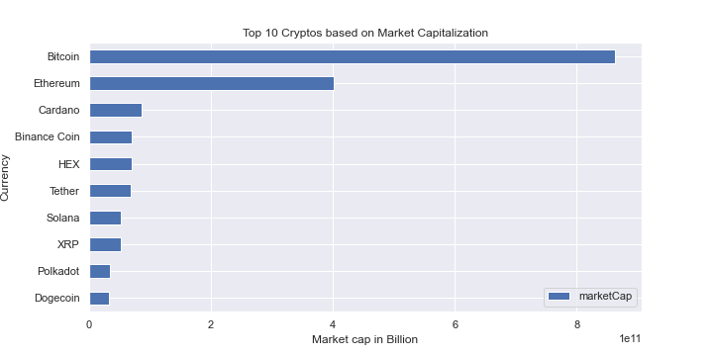
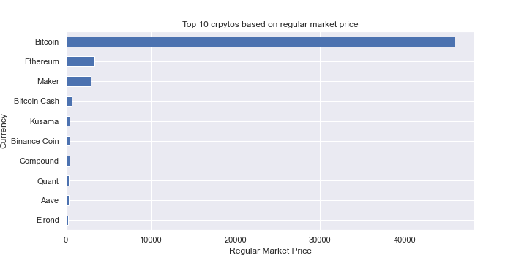
EDA contd.

Slide 13
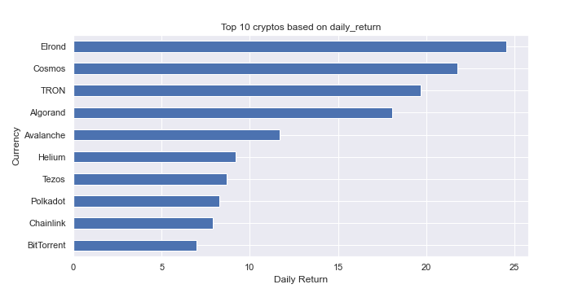
EDA CONTD.

Slide 14
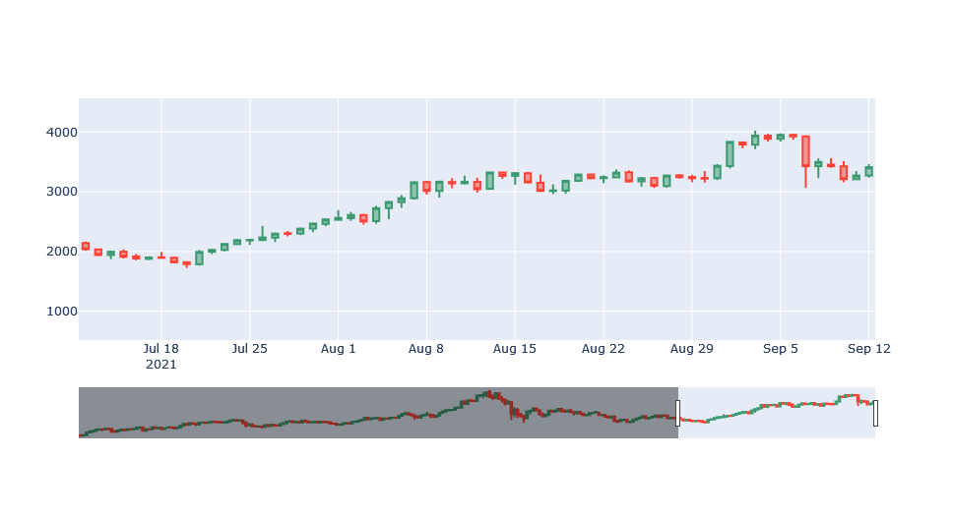
CANDLESTICK PLOT OF ETHEREUM

Slide 15
FEATURE ENGINEERING
s/n | Feature | Description
1 | Volume | This signifies the amount of coins in total.
2 | daily_return | This shows the returns per day
3 | Direction | Indicates if movement is positive or negative
4 | MA10 | Moving Average over 10 days time periods
5 | MA50 | Moving Average over 50 days time periods

Slide 16
MODEL SELECTION
Model and Algorithm
The problem is consider a time series problem and hence will be solve using the Arima model. However, classical machine learning algorithm will also be put to task to see how they perform.
1. Linear Regression
2. A.R.I.M.A model
Evaluation Metrics
Mean Absolute Error.
Benefits of the project:
Could save investor from losing money and be intelligent using the knowledge of data and machine learning to guide their investment on cryptocurrency.
Building a world of stable coins

Slide 17
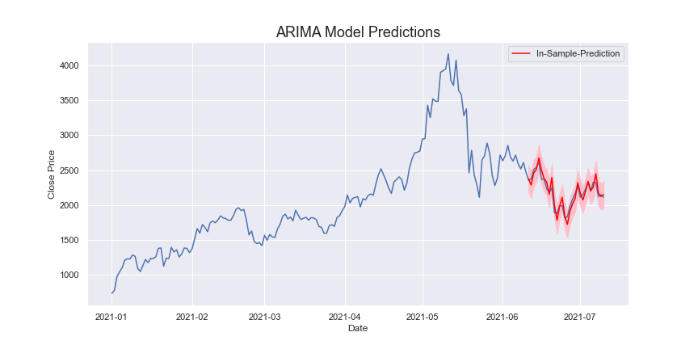
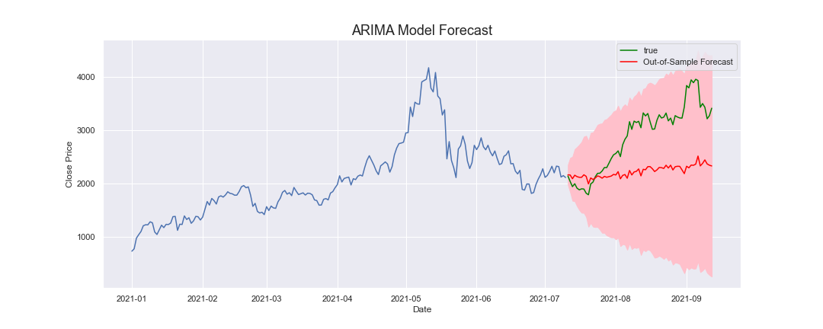
ARIMA MODEL

Slide 18
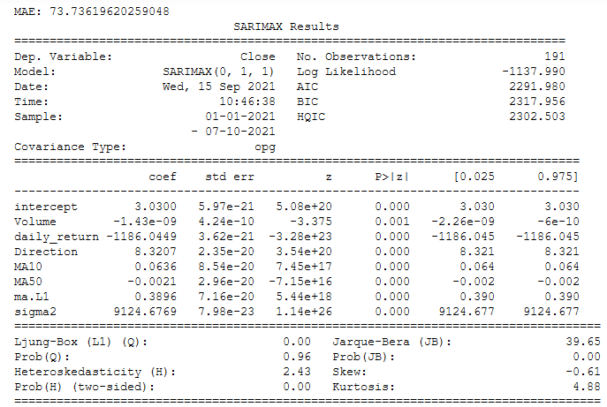
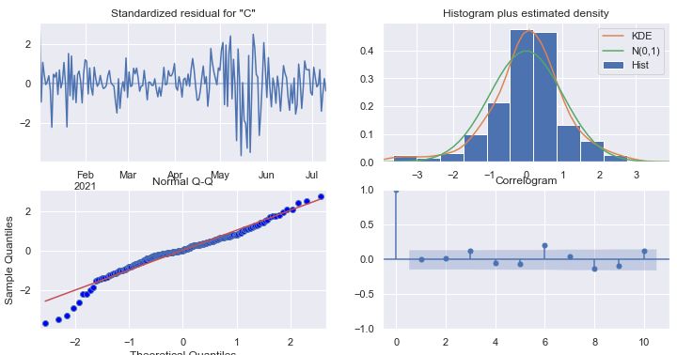
ARIMA Model Results

Slide 19
CONCLUSION
INSIGHTS:
This project develops machine learning models in the area of cryptocurrency to predict and decipher the coin which would be secure, stable and serve as the next huge investment in the coming years.
FUTURE WORK AND RECOMMENDATIONS:
MODEL DEPLOYMENT: DEPLOY OUR ARIMA MODEL FOR PRODUCTION
GET MORE HISTORICAL DATA
USE BLEEDING EDGE ML TECHNIQUES: DEEP LEARNING WITH LSTM, PROPHET

